Slide 1
MIS
Management Information System
2019 FTA Drug & Alcohol Program
National Conference
Milwaukee, WI
https://damis.dot.gov
(617) 494-6336

Slide 2
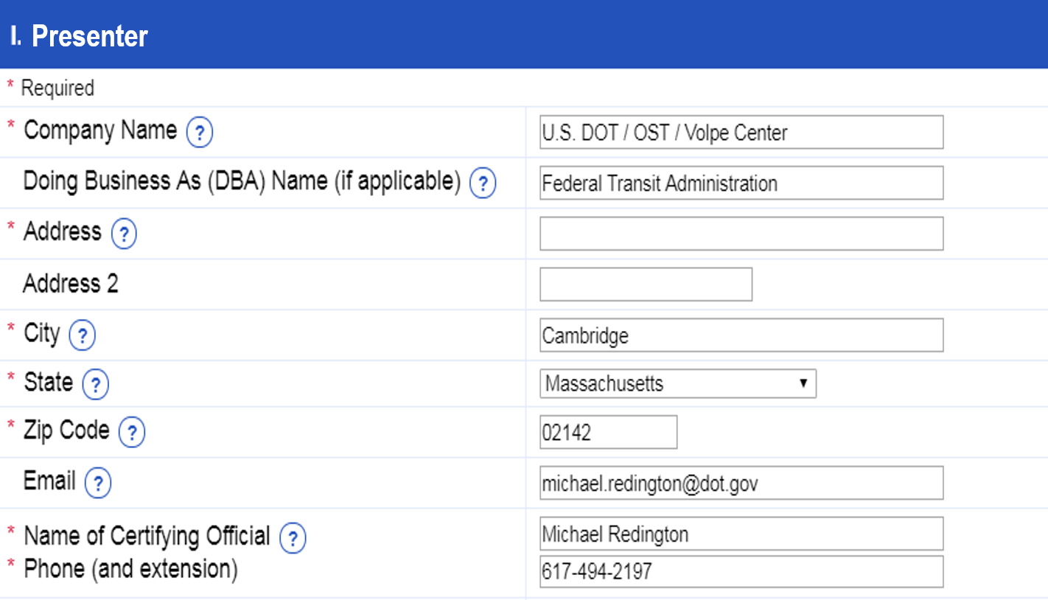

Slide 3
Regulations
FTA – 49 CFR Part 655.72
Annually “prepare and maintain” summary of results of testing program
Submit “when requested” – March 15th
Each recipient of FTA funding
“Each recipient must be responsible and ensure accuracy and timeliness of each report submitted by an employer, contractor, consortium, joint enterprise or third party service provider”
DOT / ODAPC – 49 CFR Part 40.26
Use form in Appendix H of Part 40
Report according to rule requirements of DOT agency

Slide 4
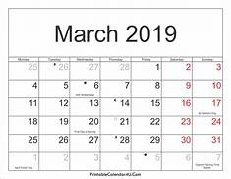
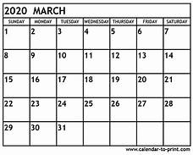
Notification
Letter – Late December to All FTA Grantees
Submissions due by March 15th
Usernames and Password – http://DAMIS.DOT.GOV
Instructions on “How to Report”
MIS
MIS

Slide 5
FAQs
For what period do I report my testing results?
The Previous Calendar Year (1/1 – 12/31).
Does my username and password ever change?
YES – It changes each reporting year (calendar year…1/1).
How do my contractors/subrecipients get their usernames & passwords?
The grantee is responsible for distributing them.

Slide 6
FAQs
Do I report all drug and alcohol test results?
Not necessarily.
Do not report non-DOT results.
Do not report non-FTA results.
I have my FTA-covered contractors in the random pool with my FTA-covered employees, can I report “the pool”?
No, each ‘employer’ submits a separate MIS.
Do I report pre-employment test results, even if applicant was not hired or never performed a safety-sensitive function?
Yes, report all testing performed under FTA authority.

Slide 7
FAQs
I have a CCF that was checked FMCSA but should be FTA, how should that test result be reported?
The CCF should be corrected. Report as marked.
My contractor began service mid-year, how do I report their data?
There is no place to indicate ‘partial year’. Report results as they are.
The MRO cancelled a test and required a recollection. What do I report?
Report 1 cancelled test and 1 result.

Slide 8
Common Errors
Did not provide consortium or third party administrator (C/TPA) information
Included FMCSA testing results with FTA
Not all covered employers submitted
Contractors (Maintenance)
In the same Random Pool
Submitted same testing results information multiple times
Sent to FTA & FMCSA
Submission is late
Combined data for multiple employers on one MIS report
Submitted ‘Contractor’ report as Grantee because Grantee is pass-through

Slide 9
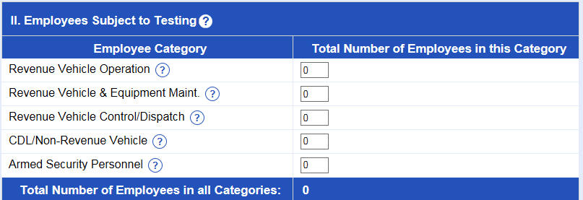
Common Errors
Reported incorrect number of “Employees Subject to Testing”
“Employees Subject to Testing”
Number of Individuals in the Pool

Slide 10
How to Calculate: ”Employees Subject to Testing”
Average number of FTA-Covered Employees in your Random Testing Pool(s), for each employer, at the time of the Random Selection
Example – Using Quarterly Random Selections
1st Quarter = 56
2nd Quarter = 61
3rd Quarter = 63
4th Quarter = 60
TOTAL = 240 FTA-Covered Employees / 4 Quarters = 60
60 = “Total Number of Employees in All Categories”

Slide 11
How to Calculate: ”Employees Subject to Testing” - FAQ
What if an employee works across multiple employee categories (e.g., Rev Veh Op & Rev Veh Cntrl/Dsptch)?
Report that employee in only one employee category – the category in which they worked the most hours for that CY.
What if an employee is part-time?
A PT and FT employee are both counted as ‘1’ employee.

Slide 12
General Rules
Report What Happened
If a DOT/FTA was performed, even if it should not have been performed…report it on MIS. (Unless it was downgraded.)
Report the Final Result
Do Not Double Report
Do not report same test result on multiple MIS submissions

Slide 13
How to Compile Data for MIS
655.72(c) states: “Each recipient shall be responsible for ensuring the accuracy and timeliness of each report submitted by an employer, contractor, consortium or joint enterprise or by a third party service provider acting on the recipient's or employer's behalf. ”
Do not use semi-annual lab report
Does not include verified (by MRO) results
Suggested:
Count up CCFs and ATFs
Whatever method “ensures accuracy”

Slide 14
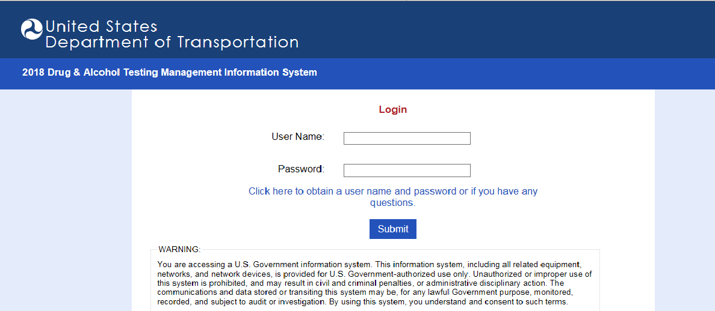
https://DAMIS.DOT.GOV

Slide 15
MIS DATA
* Partial data (90%)

Slide 16
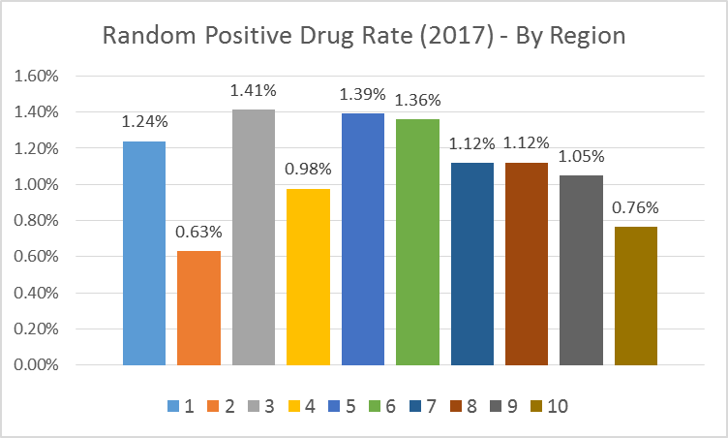
MIS

Slide 17
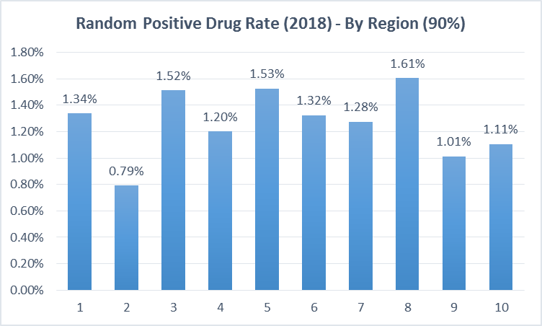

Slide 19
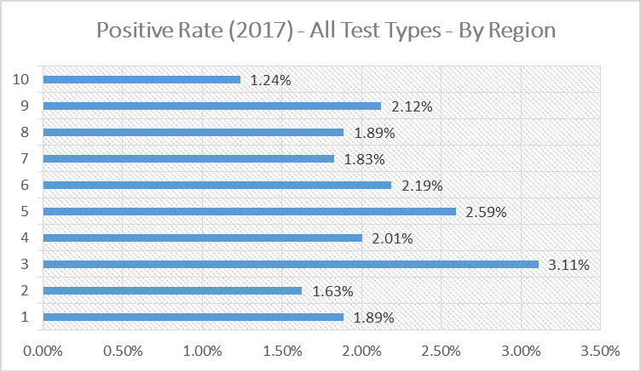
MIS

Slide 20
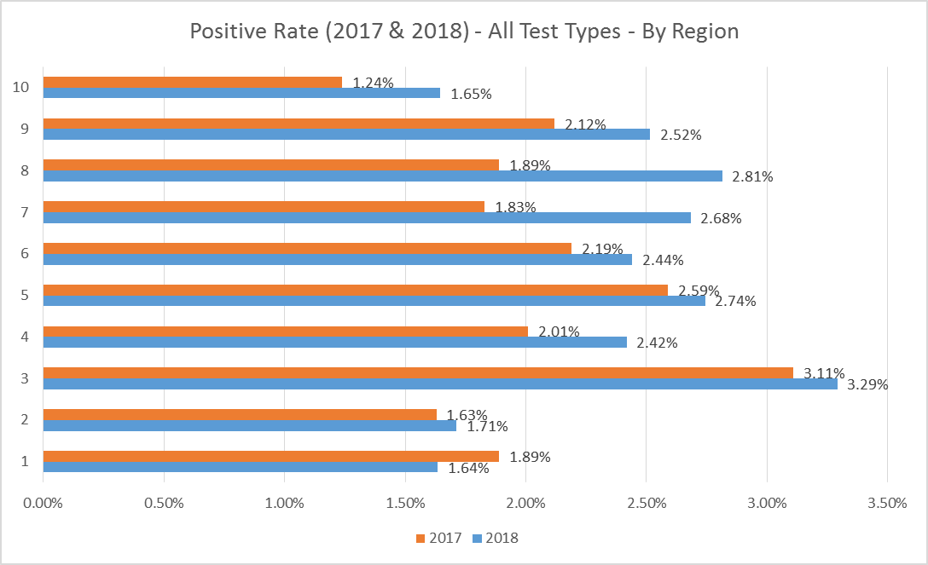

Slide 21
MIS DATA
92%

Slide 22
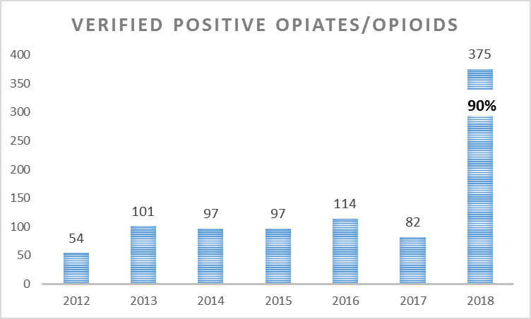
MIS DATA

Slide 23
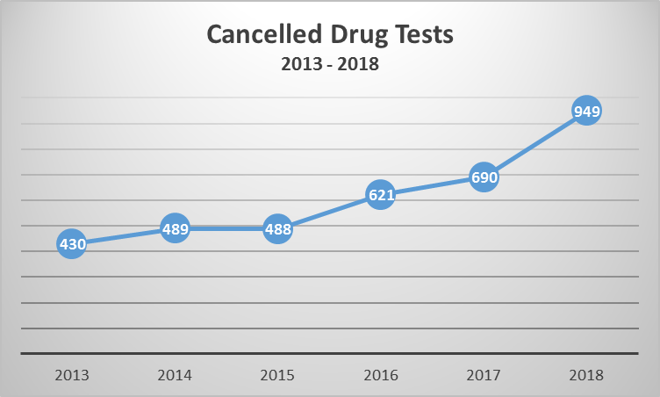

Slide 24
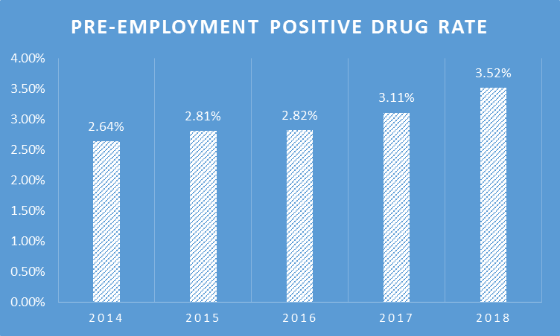

Slide 25
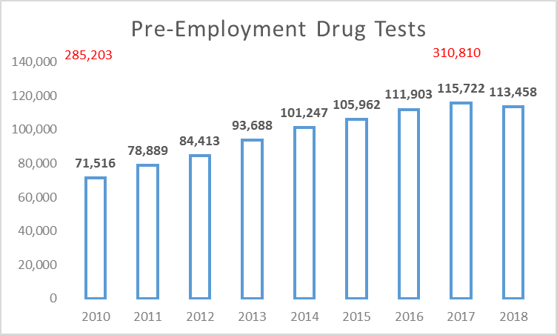

Slide 26
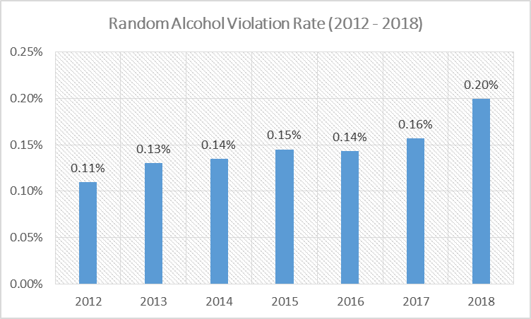

Slide 27
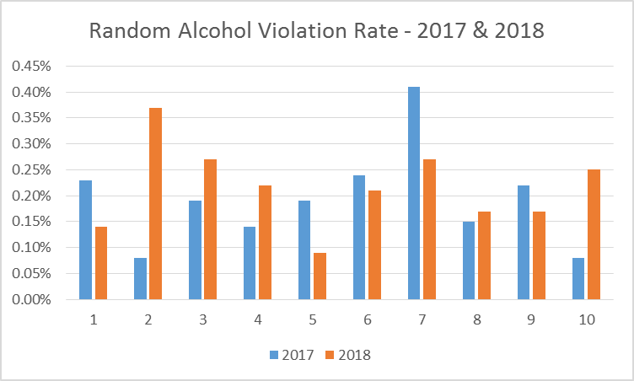

Slide 28
PRE-EMPLOYMENT ALCOHOL TEST RESULTS
YEAR | SCREENING TEST RESULTS | CONFIRMATION TEST RESULTS 0.04 OR GREATER + REFUSALS | VIOLATION RATE
2014 | 16,781 | 10 | 0.060%
2015 | 19,506 | 20 | 0.103%
2016 | 19,101 | 18 | 0.094%
2017 | 18,202 | 30 | 0.165%
2018 | 18,861 | 47 | 0.249%

